Slide 1
Software Development Tools

Slide 2
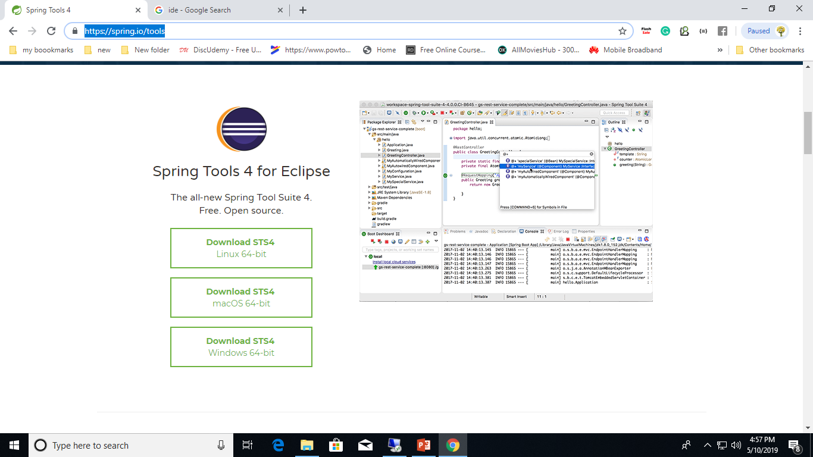
IDE: Integrated development environment
Spring Tool Suite
https://spring.io/tools

Slide 3
IDE: Integrated development environment
Eclipse : https://www.eclipse.org/ Eclipse is an IDE used in computer programming, and is the most widely used Java IDE.
Visual Studio : https://www.visualstudio.com/ Microsoft Visual Studio is an IDE from Microsoft to develop computer programs for Microsoft Windows, web sites, web apps, web services and mobile apps.
Netbeans : https://netbeans.org/ Quickly and easily develop desktop, mobile and web applications with Java, JavaScript, HTML5, PHP, C/C++ and more.
IntelliJ : https://www.jetbrains.com/idea/ IntelliJ IDEA is a Java integrated development environment for developing computer software.

Slide 4
Code Sharing Platforms :Git
Git
Git is a free and open source distributed version control system designed to handle everything from small to very large projects with speed and efficiency.
https://git-scm.com/

Slide 5
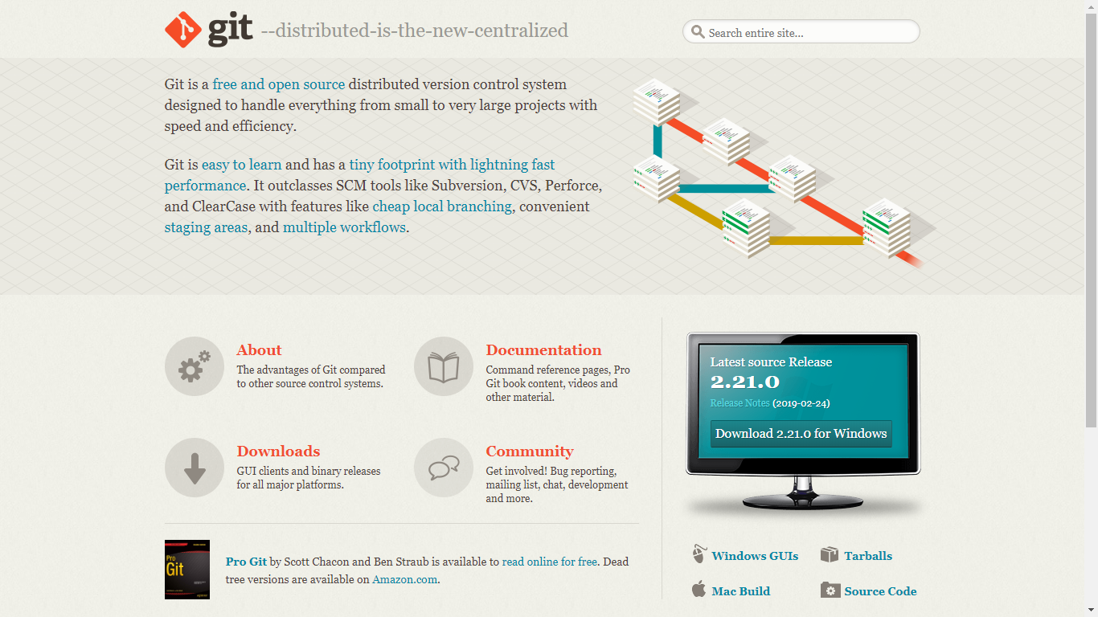

Slide 6
Code Sharing Platform
GitHub : https://github.com/ With it you can host and review code, manage projects, and build software alongside millions of other developers.
Bitbucket : https://bitbucket.org/ Distributed version control system that makes it easy for you to collaborate with your team.
GitLab : https://about.gitlab.com/ Create value faster with a single application for the whole software development and operations lifecycle.

Slide 7
Communication platform
Slack : https://slack.com/ Slack is the platform that connects teams with the apps, services, and resources they need to get work done.

Slide 8
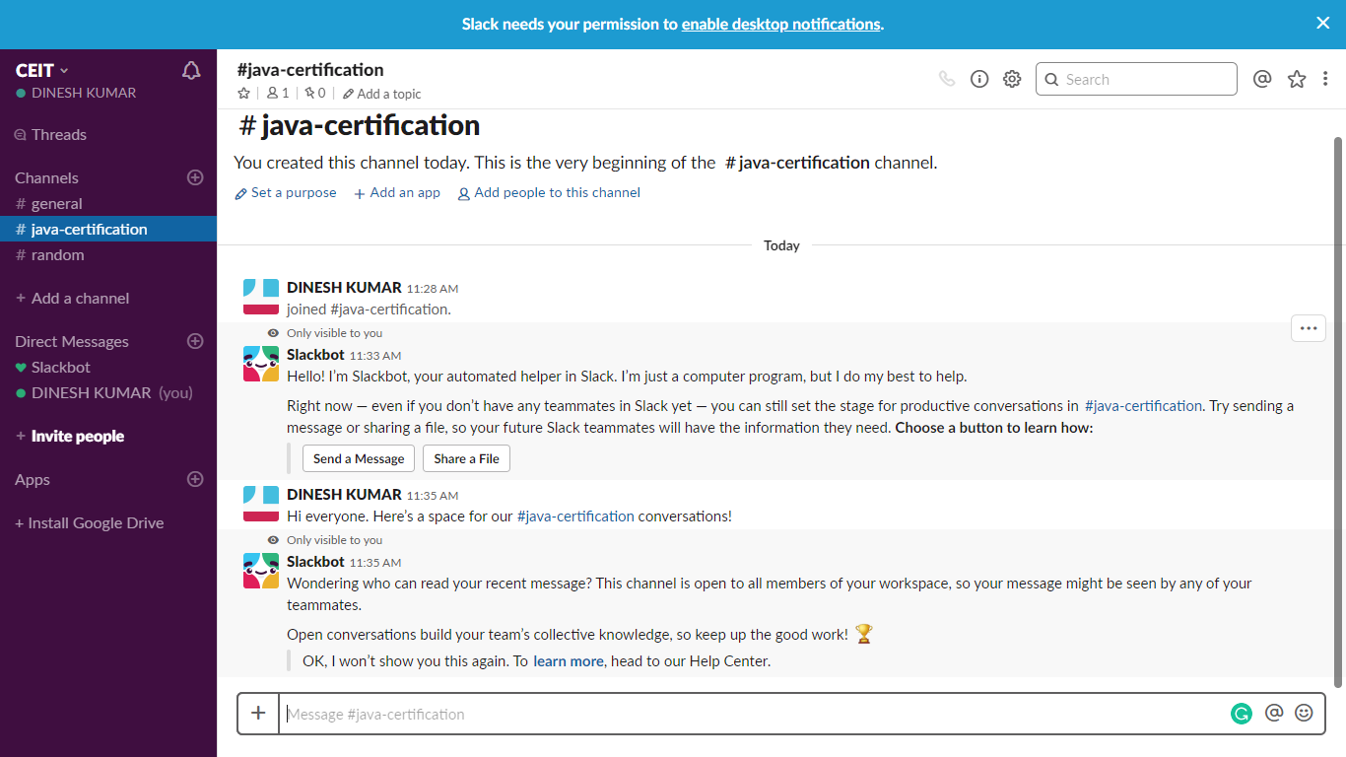

Slide 9
Continuous Integration
Jenkins
https://jenkins.io/
The leading open source automation server, Jenkins provides hundreds of plugins to support building, deploying and automating any project.

Slide 10
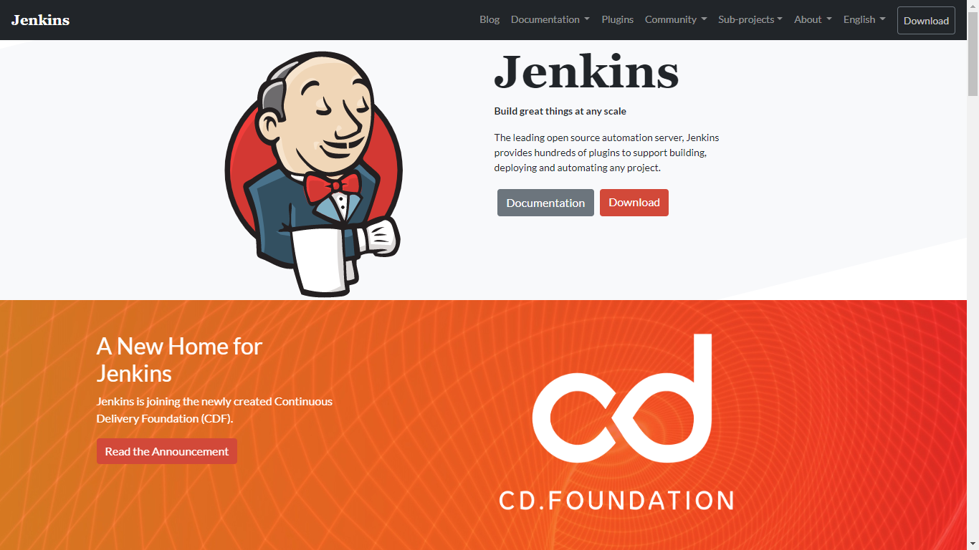

Slide 11
Thank You

